Slide 1


The Use of Address Terms in Twitter Posts in the 2020 Presidential Election
Andrew Van Horn

Slide 2
Methods
Hashtags
#Biden2020
#BidenHarris2020
#Election2020
#Trump2020
#TrumpPence2020
S | M | T | W | R | F | A
25 | 26 | 27 | 28 | 29 | 30 | 31
1 | 2 | 3 | 4 | 5 | 6 | 7
Search Term: “#Biden2020” “Donald” OR “Trump” OR “Joe” OR “Biden” OR “Kamala” OR “Harris” OR “Mike” OR “Pence” -RT

Slide 3
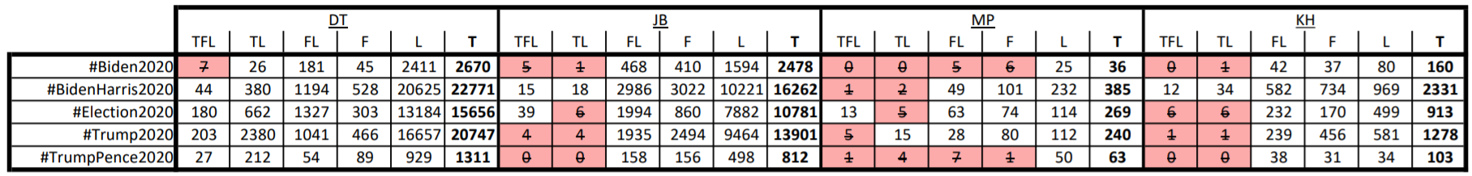
Results
Only the highest-order address term is included if mixing is present
Counts less than 10 (Marked in red) yield results which cannot be significant

Slide 4
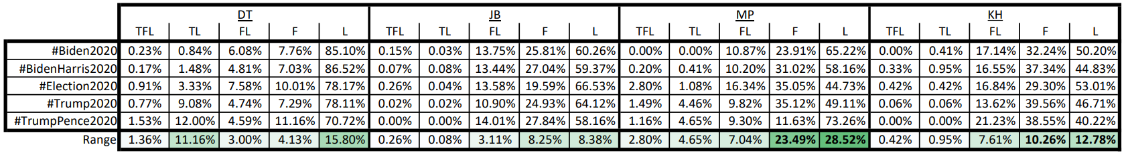
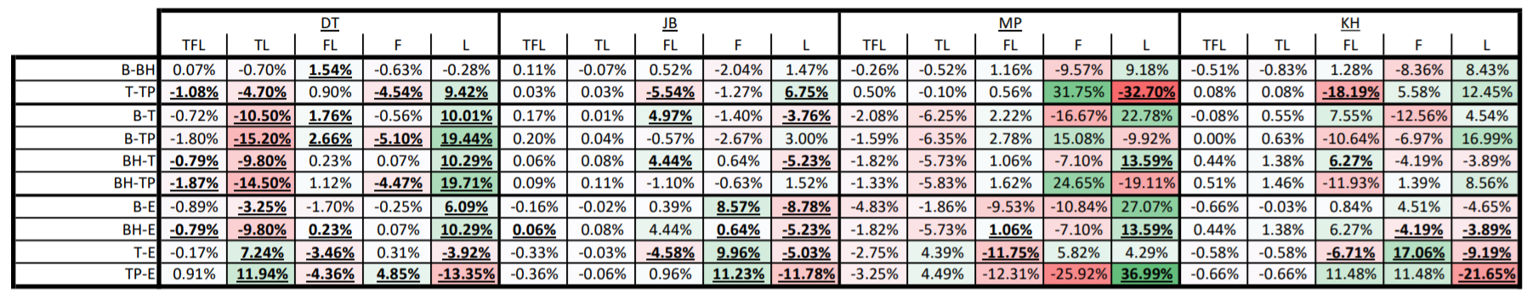
Usage Proportion by Hashtag
2-proportion z-test for significance (α<0.1%). Significant statistics are underlined

Slide 6
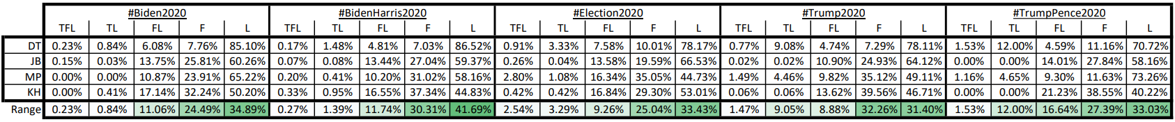
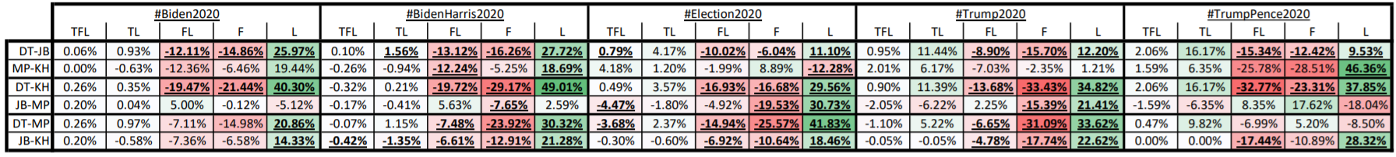
Usage Proportion by Person
2-proportion z-test for significance (α<0.1%). Significant statistics are underlined

Slide 7
L Preference
DT
JB
MP
KH

Slide 8
Questions?

